Slide 1

Cochlear Implants:
Auditory & Developmental Neuroscience
Dan Ofer

Slide 2
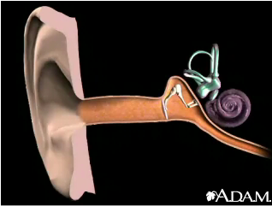
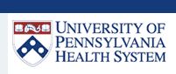
Normal Hearing - Anatomy
Middle ear
Outer ear
Inner ear
(cochlea)

Slide 3
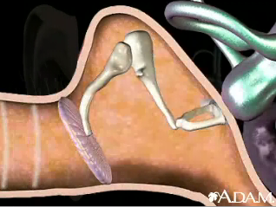
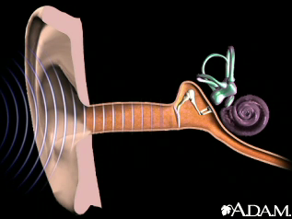
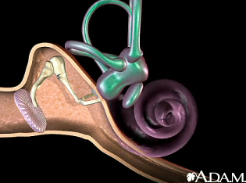
How Do We Normally Hear?
The eardrum and middle ear vibrate…
Ear drum
Sound enters ear…
Transduced to neural impulses, then brain via auditory nerve.
Creating pressure within the cochlea…

Slide 4
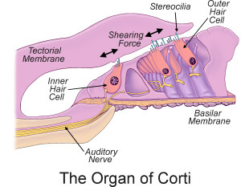
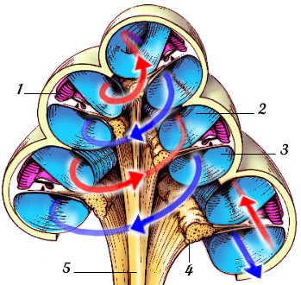
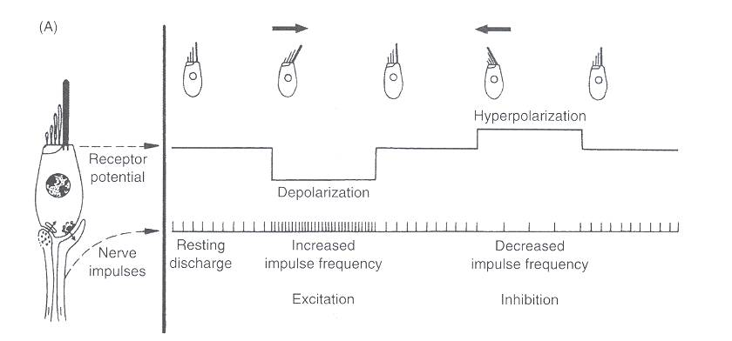
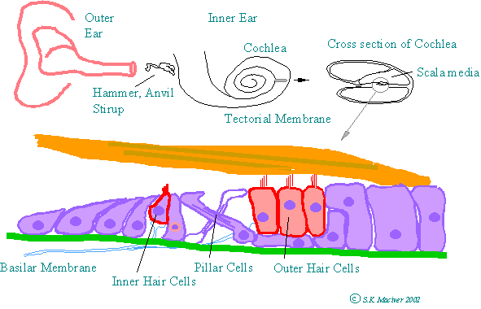
The Cochlea: Sound to Neural Impulses
Cochlea Cross-section
http://www.iurc.montp.inserm.fr/cric/audition/

Slide 5
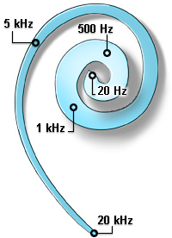
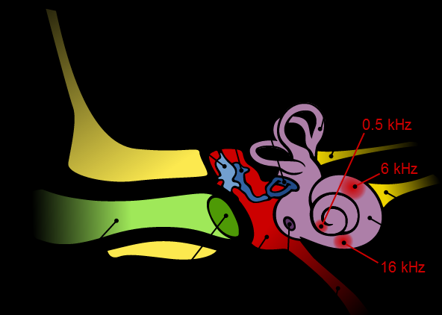
Tones and the Cochlea: Tonotopic!
Low frequency
High frequency

Slide 6

Hearing Loss
Can happen due to disease, genetics, damage, age..
Common causes :
Damage to hair cells (Inner and/or outer) due to innate vulnerability.
Partial damage to auditory nerve.
Damage to components in parts of ear.
Etc..

Slide 7
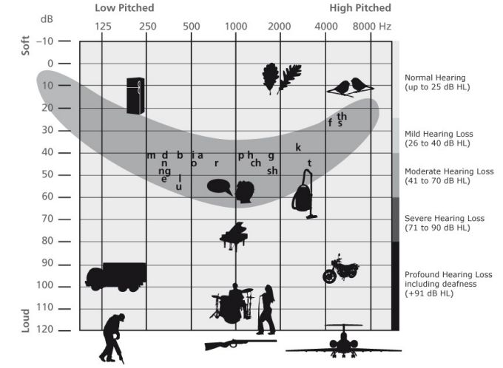
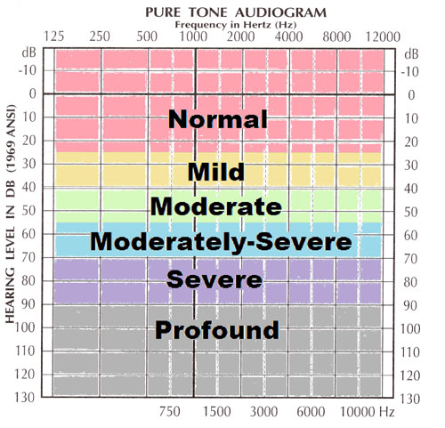

Hearing Loss Levels
-10 - 25 dB HL: normal hearing
> 90 dB HL: profound hearing loss
Reminder: (dB is a LOG scale! ${10}^{x}$!!)
http://auditoryneuroscience.com/acoustics/clinical_audiograms
http://www.phonak.com/com/b2c/en/hearing/understanding_hearingloss/types_of_hearing_loss.html

Slide 8
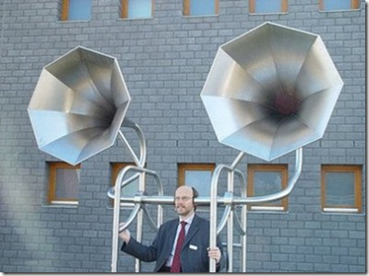
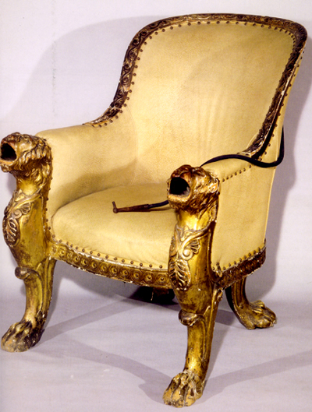
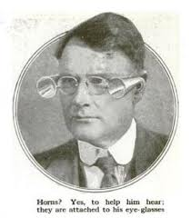
Hearing Aids = Amplify

Slide 9
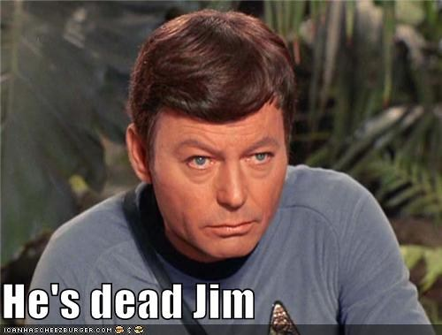
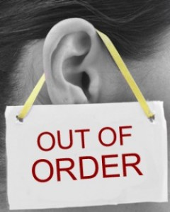
What happens when “no” residual hearing left to amplify???
PROFOUND-Severe Hearing Loss

Slide 10
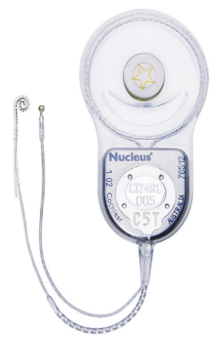
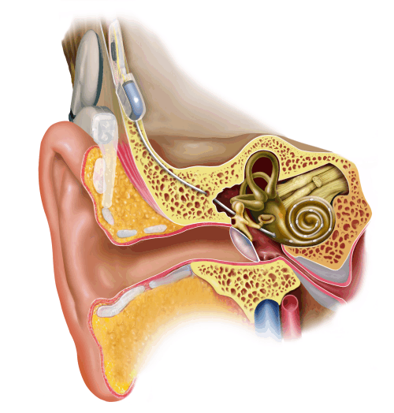
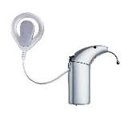
Cochlear Implants
Receiver.
Microphone + Emitter
Auditory Nerve
Speech Processor
Stimulating implant
electrodes
Notes:
http://www.google.co.uk/url?sa=i&rct=j&q=&esrc=s&source=images&cd=&cad=rja&docid=axByeOIGW0GhLM&tbnid=1Yyuw4kHiQ16RM:&ved=0CAQQjB0&url=http%3A%2F%2Fwww.felixmay.com%2FESB%2Fbrainimplants.htm&ei=NpgjUZ2SBa-U0QWSs4C4BA&bvm=bv.42553238,d.d2k&psig=AFQjCNEER2EQYwko97k1AabpNT_upWWrZw&ust=1361373577987926

Slide 11
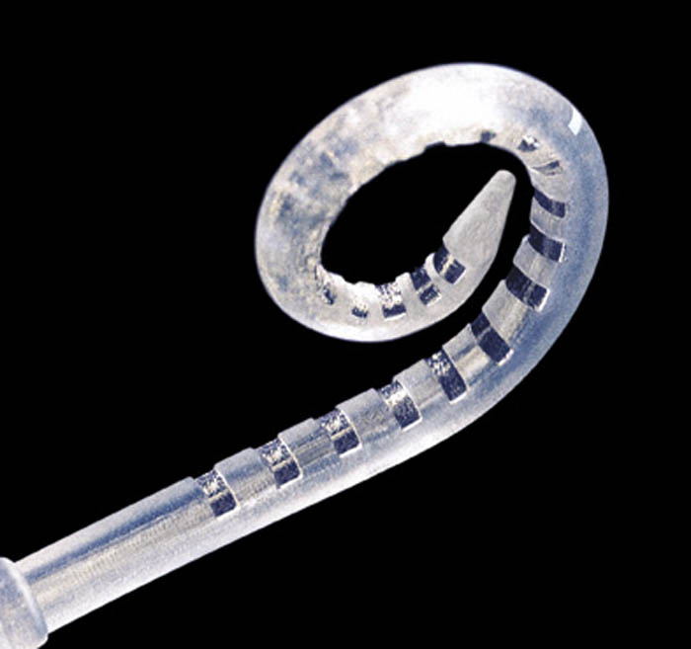
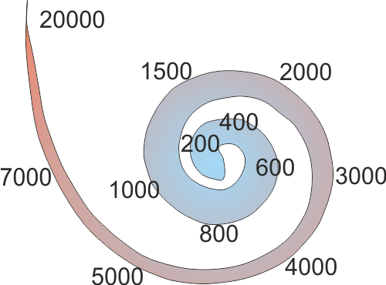
Cochlear Implants: Stimulating Electrodes inside the Organ of Corti
Notes:
http://www.google.co.uk/url?sa=i&rct=j&q=&esrc=s&source=images&cd=&cad=rja&docid=axByeOIGW0GhLM&tbnid=1Yyuw4kHiQ16RM:&ved=0CAQQjB0&url=http%3A%2F%2Fwww.felixmay.com%2FESB%2Fbrainimplants.htm&ei=NpgjUZ2SBa-U0QWSs4C4BA&bvm=bv.42553238,d.d2k&psig=AFQjCNEER2EQYwko97k1AabpNT_upWWrZw&ust=1361373577987926

Slide 12
Electric Activation with Cochlear Implant
Hair Cells
Auditory Nerves
Notes:
Introduce sensorineural hearing loss
Animation of cochlear implant functioning with neural signaling

Slide 13

Limitations of Cochlear Implants
The electrode array does not reach all the way in.
Modern implants = ~20 electrode channels, but lots of electrical “noise”, because of the highly conductive perilympthatic fluid.
# “Effective” separate frequency channels is even lower ( ~ 9).
Compare to ~3,500 natural Inner Hair Cells (with amplification + compression by 12,000 Outer hair cells!)

Slide 14
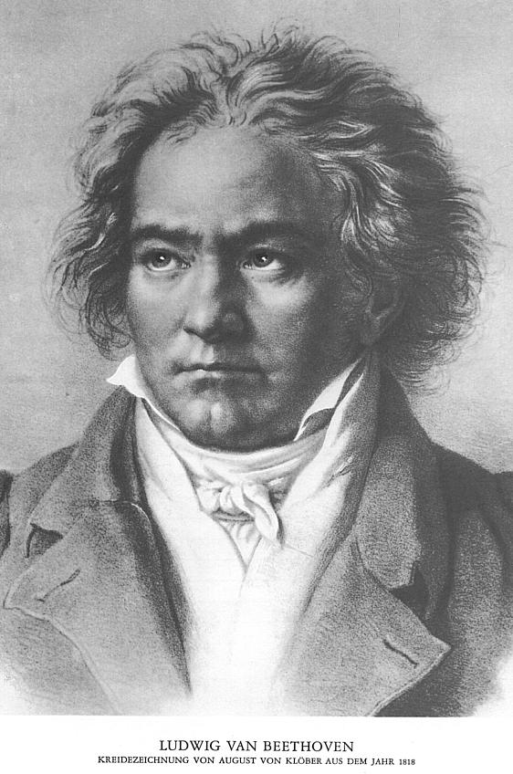
Cochlear Implants Music in your Ears?
Normal Ludwig
CI Ludwig
http://auditoryneuroscience.com/prosthetics/music
http://auditoryneuroscience.com/prosthetics/noise_vocoded_speech

Slide 15
Factors Effecting Cochlear Implant Performance
Age at time of implant
Age of onset of deafness
Duration of deafness
Others:
Commitment!! (family and individual)
Therapy, training..

Slide 16
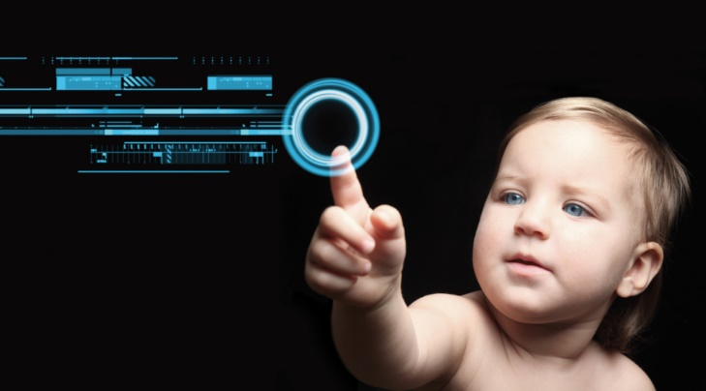
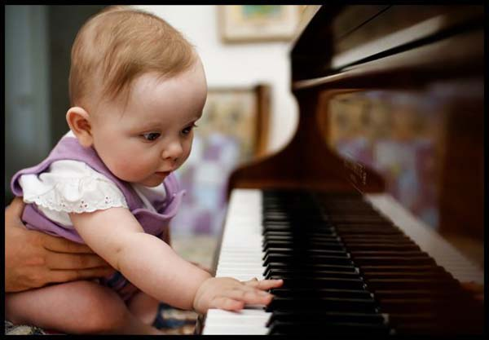
The Problem with Age: The Early brain:
Young | Old
Learning is Easy | Learning is HARD!
Totally new abilities acquired (walking, talking..) | No new “tricks”.
* Bavelier, & Hensch et al.. (2010). Removing brakes on adult
brain plasticity: From molecular to behavioral interventions. Journal of Neuroscience,

Slide 17
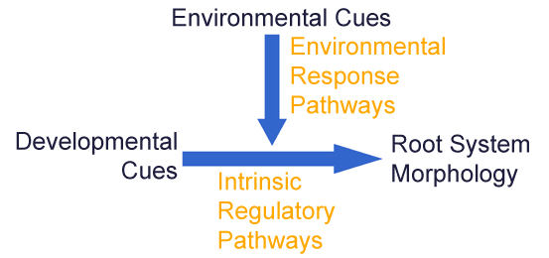
Experience and Neurodevelopmental periods
Experience Dependent Plasticity ~= Environmental input modulates.
Doesn’t apply for all cortical circuits!
Different types, circuits, periods.
Depends on organism, even for the same senses ..

Slide 18
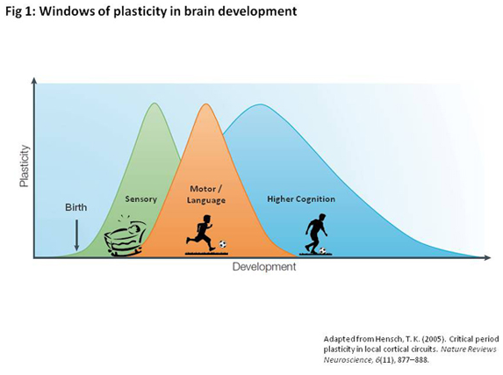
Sensitive periods
Periods of increased sensitivity during development.
Effects of experience are enhanced.
Quantitative Difference
Notes:
(Second) Language. Skills. Social normas & behavior

Slide 19
Sensitive periods (II)
(Secondary) Languages
LeBlanc JJ, Fagiolini M. Autism: a "critical period" disorder? Neural Plast. 2011
Montessori, Maria (1949). The Absorbent Mind

Slide 20
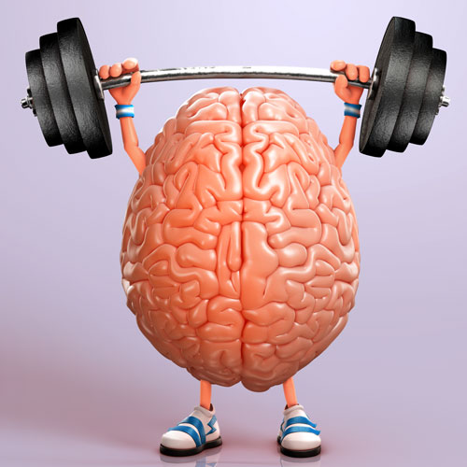
Critical periods
A strict time window during which environmental experience provides information essential for a function’s development and “fixates” it, permanently.
Qualitative Difference
CRITICAL PERIOD PLASTICITY IN LOCAL CORTICAL CIRCUITS. Hensch. NATURE REVIEWS NEUROSCIENCE. (2005)

Slide 21


Critical period: Parental Imprinting

Slide 22
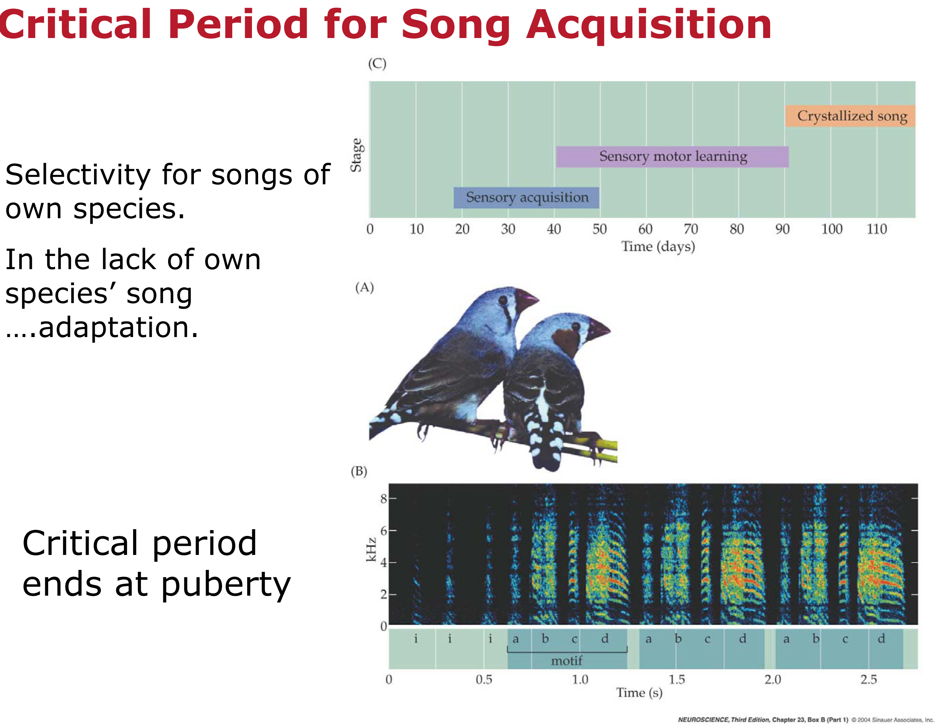

Slide 23
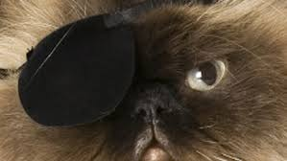

Critical period: ocular dominance monocular deprivation
Hubel & Wiesel.
Showed that ocular deprivation during CP causes monocular dominance, Ambylopia.
Only if done during critical period.
Wiesel, Hubel (1963). "Effects of visual deprivation on morphology and physiology of cell in the cat's lateral geniculate body". Journal of Neurophysiology

Slide 24
Spoken Language Development in Children Following Cochlear Implantation
Goal: “To assess spoken language acquisition following cochlear implantation in young children.”
Examined over 3 Years, with children under 5.
Metric: Performance on measures of spoken language comprehension and expression (Reynell Developmental Language Scales).
JAMA. 2010 Apr 21;303(15):1498-506. doi: 10.1001/jama.2010.451.
Niparko JK, Tobey EA, Thal DJ, Eisenberg LS, Wang NY, Quittner AL, Fink NE; CDaCI Team.

Slide 25
Spoken Language Development in Children Following Cochlear Implantation
Research Question: Effects of age at time of cochlear implantation on improvement in deaf children.
“The younger the better” ?
+ Effects of other co-variables. (Deaf parents, home, prior level of hearing, etc’ ).
Expression & Comprehension scores:
Vs other age groups.
Vs Comparable hearing peers.
JAMA. 2010 Apr 21;303(15):1498-506. doi: 10.1001/jama.2010.451.
Niparko JK, Tobey EA, Thal DJ, Eisenberg LS, Wang NY, Quittner AL, Fink NE; CDaCI Team.

Slide 26
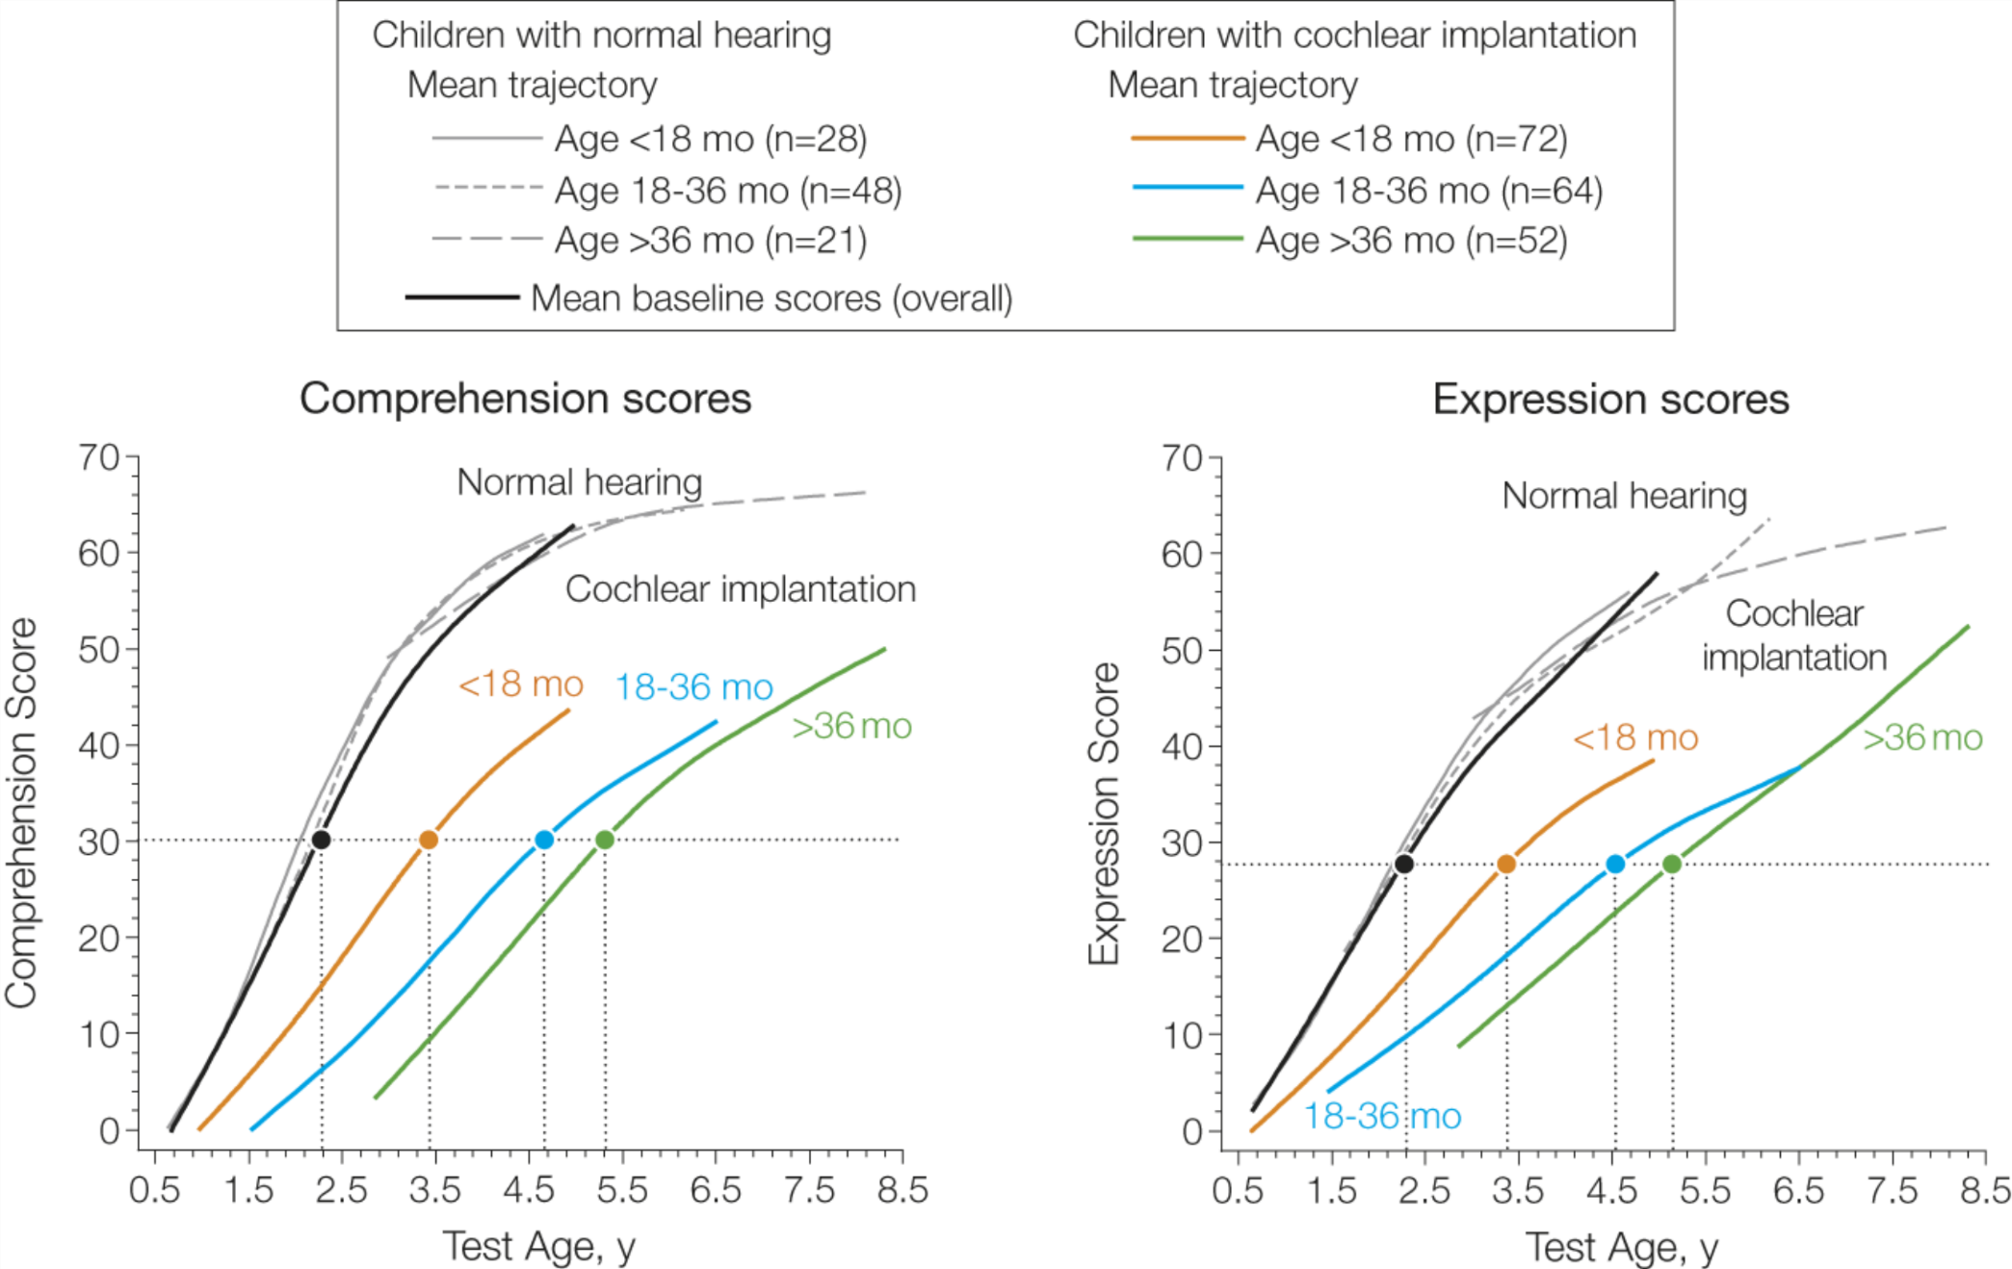
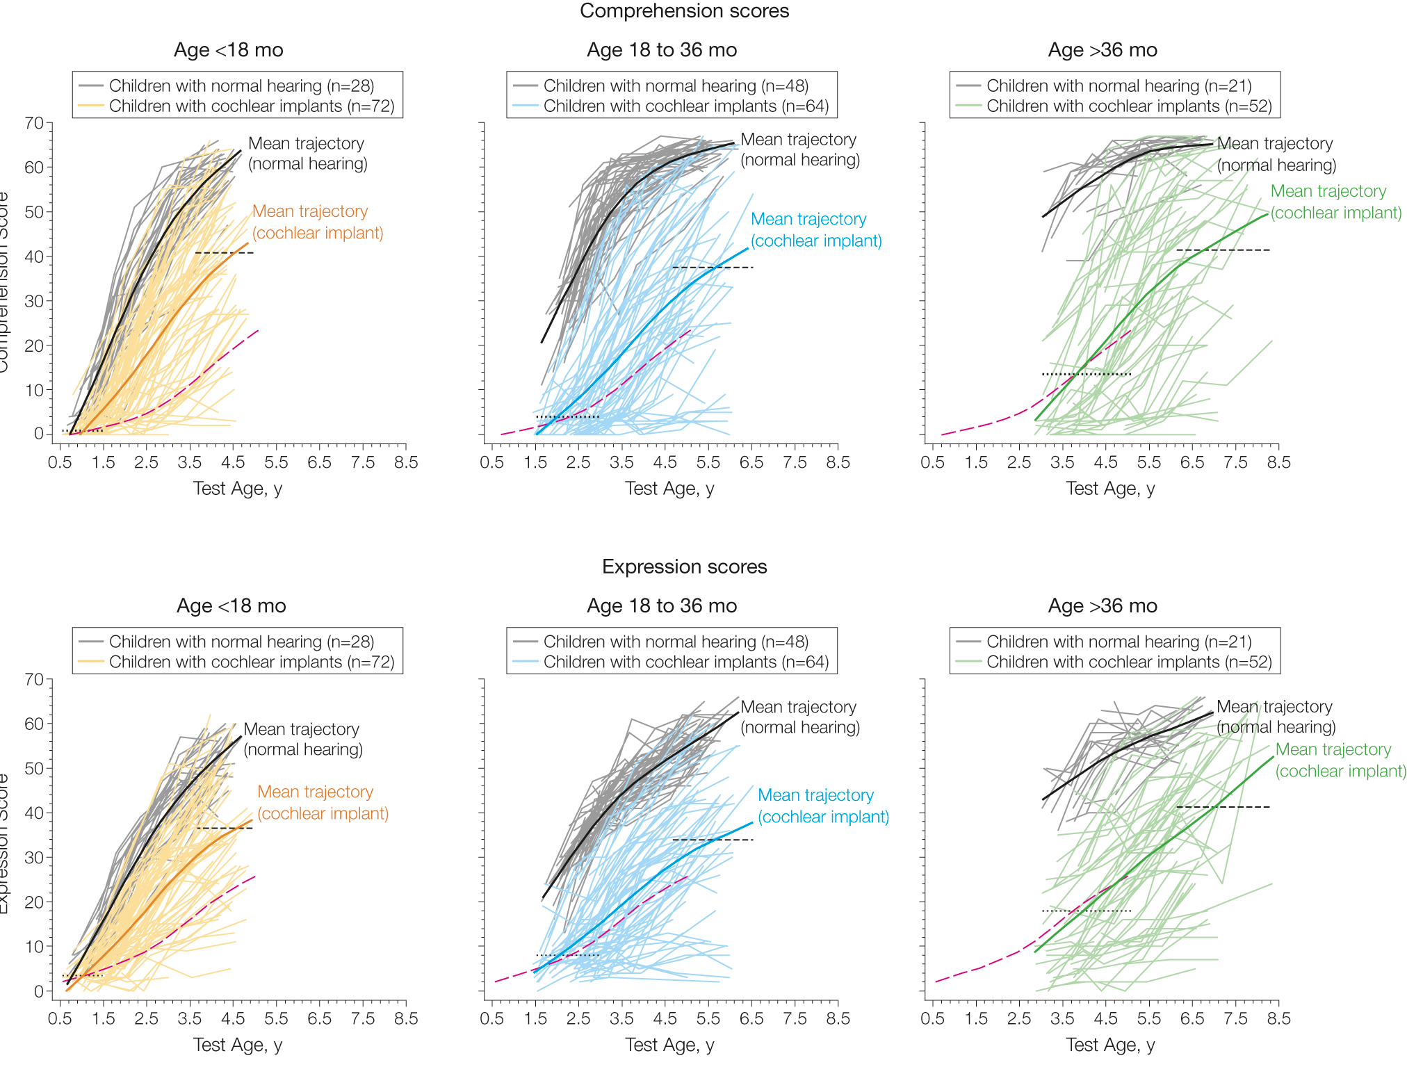
Spoken Language Development in Children Following Cochlear Implantation
Groups:

Slide 27
From: Spoken Language Development in Children Following Cochlear Implantation
JAMA. 2010;303(15):1498-1506.

Slide 28
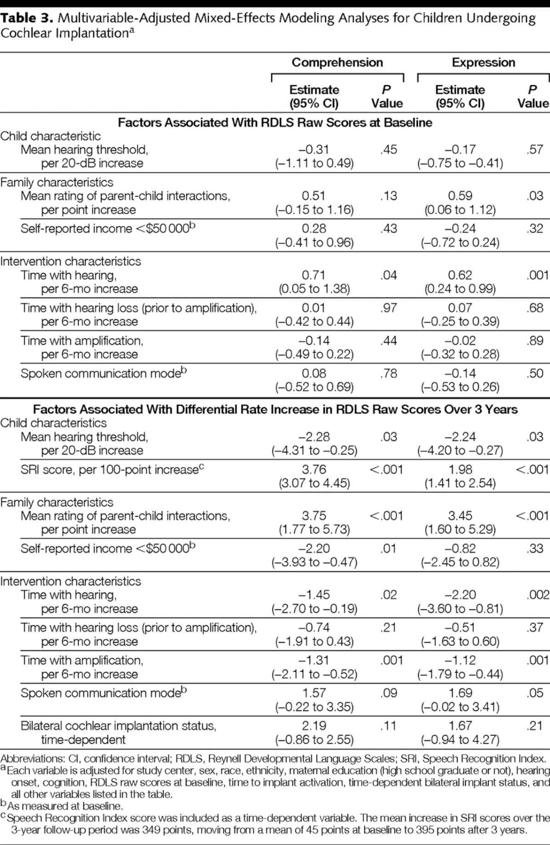
Time spent Deaf. (Age)
Prior level of hearing.
Parents.
Clear Improvement!
From: Spoken Language Development in Children Following Cochlear Implantation
JAMA. 2010;303(15):1498-1506.

Slide 29
Conclusions:
Severe-Profoundly deaf children should get a unilateral cochlear implant as young as possible (~12 months) *
Less time deaf = better and faster outcomes.
Cochlear implants improve expression and comprehension (for children and post-lingually deaf adults).
Lots of room for improvement!
Technology, resolution, biological cures (regeneration).
Reopening of critical/sensitive periods.. (Valproate!)
* “Cochlear Implants for Children with Severe-to-Profound Hearing Loss”. Blake C. Papsin, and Karen A. Gordon. N Engl J Med 2007; DOI: 10.1056

Slide 30


